Slide 1
UAS Airport Ground Traffic Simulation for vision-based UAV ground Operation
E Zhang
MS Software Engineering
Embry-Riddle Aeronautical University

Slide 2
Background
System Design
System Realization
Future Work

Slide 3
Background
System Design
System Realization
Future Work

Slide 4
Background
Background
Runway safety is a top priority at both the Federal Aviation Administration (FAA) and the National Transportation Safety Board. Reducing collision on the airport field is a major component of the effort to improve runway safety for the benefit of all air travelers.
During an UAS airport ground operation, the taxiing of an UAV can be done by a pilot sitting in the control room with the help of video feeds originated from the UAV being operated. This type of operation can be risky in busy UAS airports where other vehicles or obstacles may appear on the taxiway.
We consider a new approach for this operation---using cameras mounted on the buildings at the UAS airport to monitor the situation of the ground operation in the UAS airport. However, the testing of the proposed approach is cumbersome, risky, and costly in real UAS airports.

Slide 5
Background
Project purpose
Provide a simulation of version-based ground operation system.
Provide a simulation of the airport operation involving aircraft and airport traffic. (Create scenario for demonstration)
Set up one or more camera on the airport tower or other building which used to monitor the aircraft movement. (Obtain the image data)
With this information, The operation system will locate the aircraft and give feedback to control or steer the UAV on the runway. (Feedback Control UAV)

Slide 6
Background
System Design
System Realization
Future Work

Slide 7
System Design
Simulation - Unity3D
Use Unity3D to provide simulation scenario.
Abundant materials and Asset
Suitable for quick development
Multi-platform (support.NET )
Data Transmission - Named Pipe
Use Named Pipe to complete data transmission.
Named pipe (also known as a FIFO for its behavior) is an extension to the traditional pipe concept
Inter-process communication - to transfer data between two process on one workstation
Provides a separate conduit for client/server communication (Two - way)

Slide 8
System Design (Continued)
Image processing - MatLab
Use MatLab to process image data
A very large (and growing) database of built-in algorithms and Toolbox for image processing and computer vision applications
The ability to read in a wide variety of both common and domain-specific image formats
The source code for all image processing functions are accessible for scrutiny and test

Slide 9
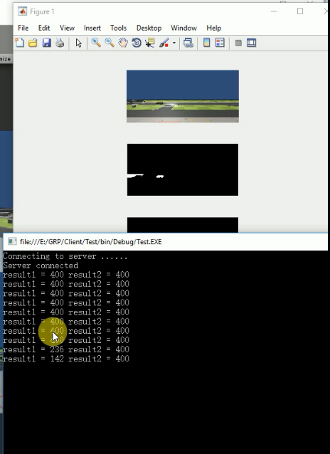
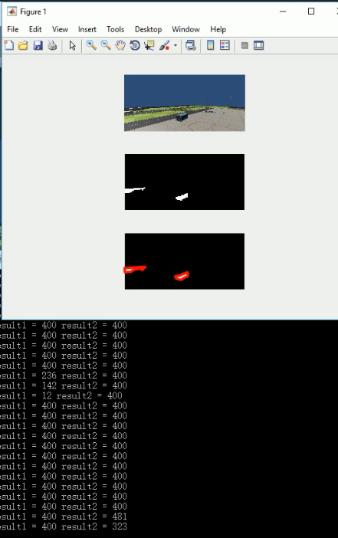
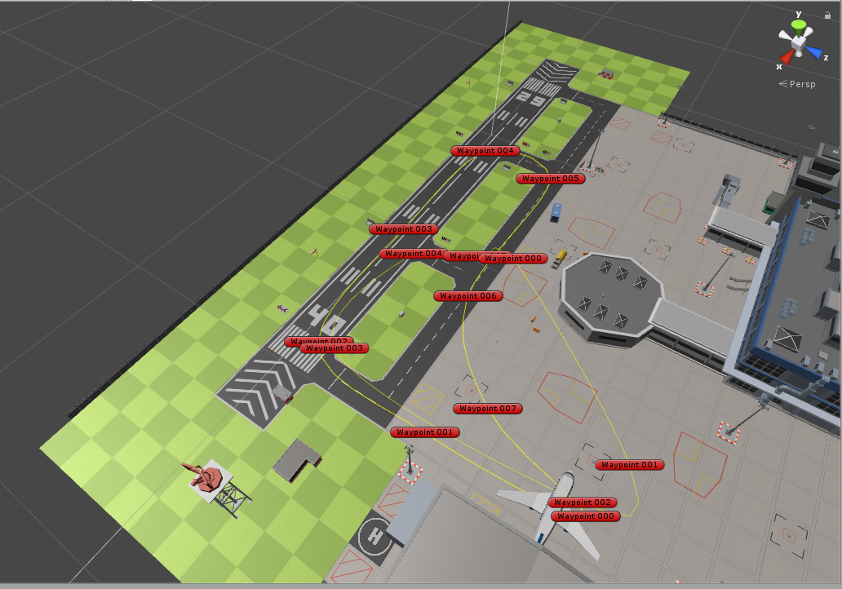
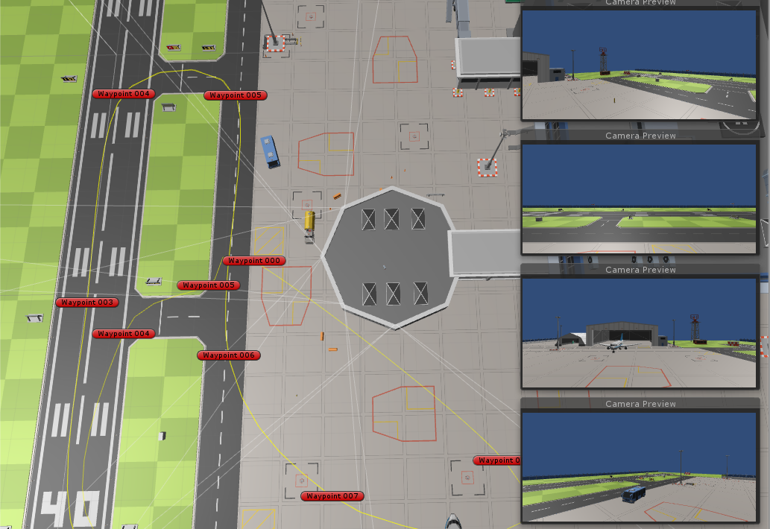
System Design
Demonstration
Environment picture
Camera location
Pipe Console & MatLab
Video Demo

Slide 10
Background
System Design
System Realization
Future Work

Slide 11
System Realization
Unity3D Simulation
1. Path setting & generation
2. UAV and vehicle control
3. UAV and vehicle path planning
Named Pipe Translation
1. Pipe Server
2. Pipe Client
MatLab Image Process
Image process

Slide 12
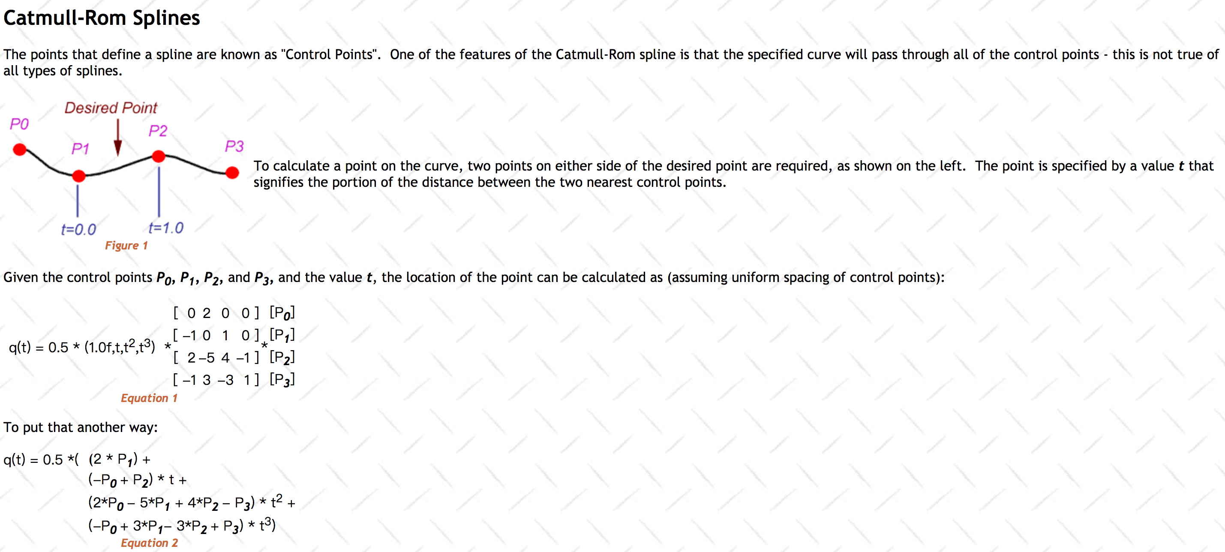
System Realization
Unity3D Simulation
1. Path setting & generation

Slide 13
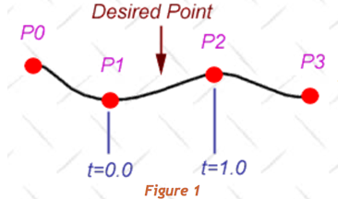
System Realization
Unity3D Simulation
1. Path setting & generation
Input: Way points position Output: Smooth path way points
Get every point position & distance to the start point;
Divide total distance into several parts based on smooth parameter (bigger = smoother)
For each part distance (equal to each path way point)
Get two nearest setting way point
Find interpolations value between two points
Get two more surrounding points
Calculate smooth path way point
Return all path way points

Slide 14
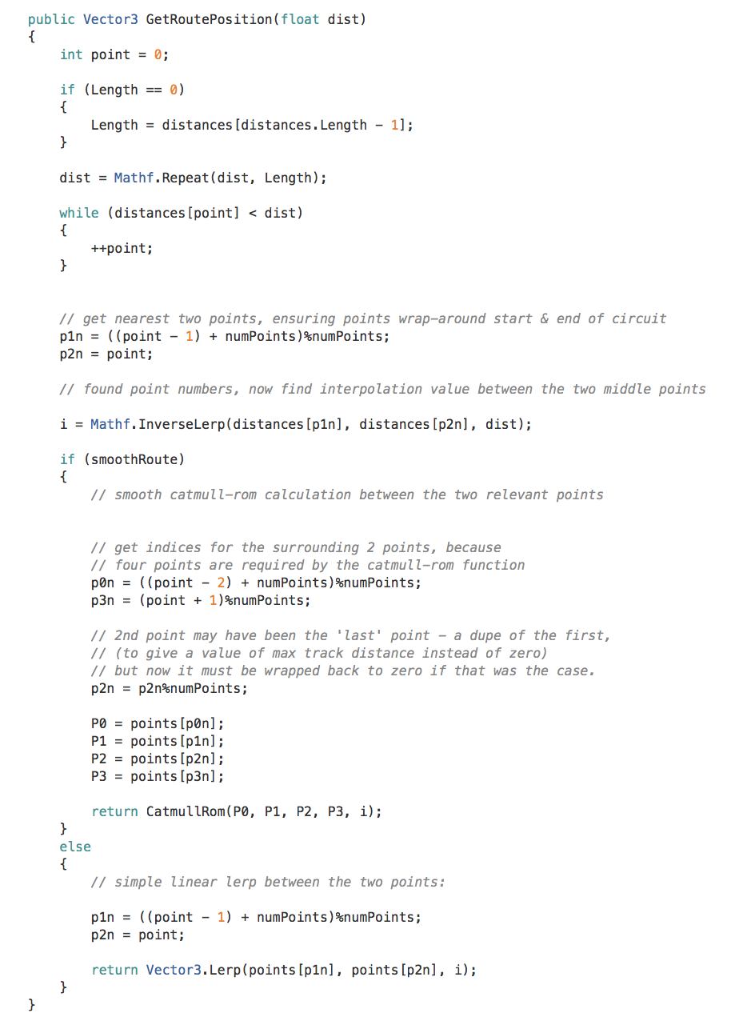
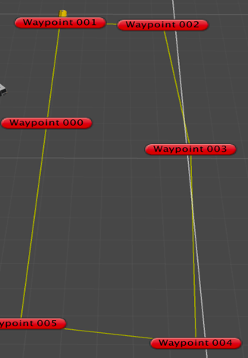
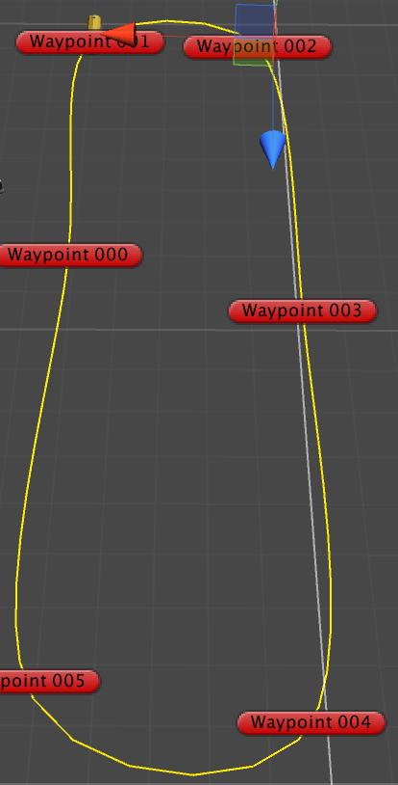
System Realization
Unity3D Simulation
1. Path setting & generation

Slide 15
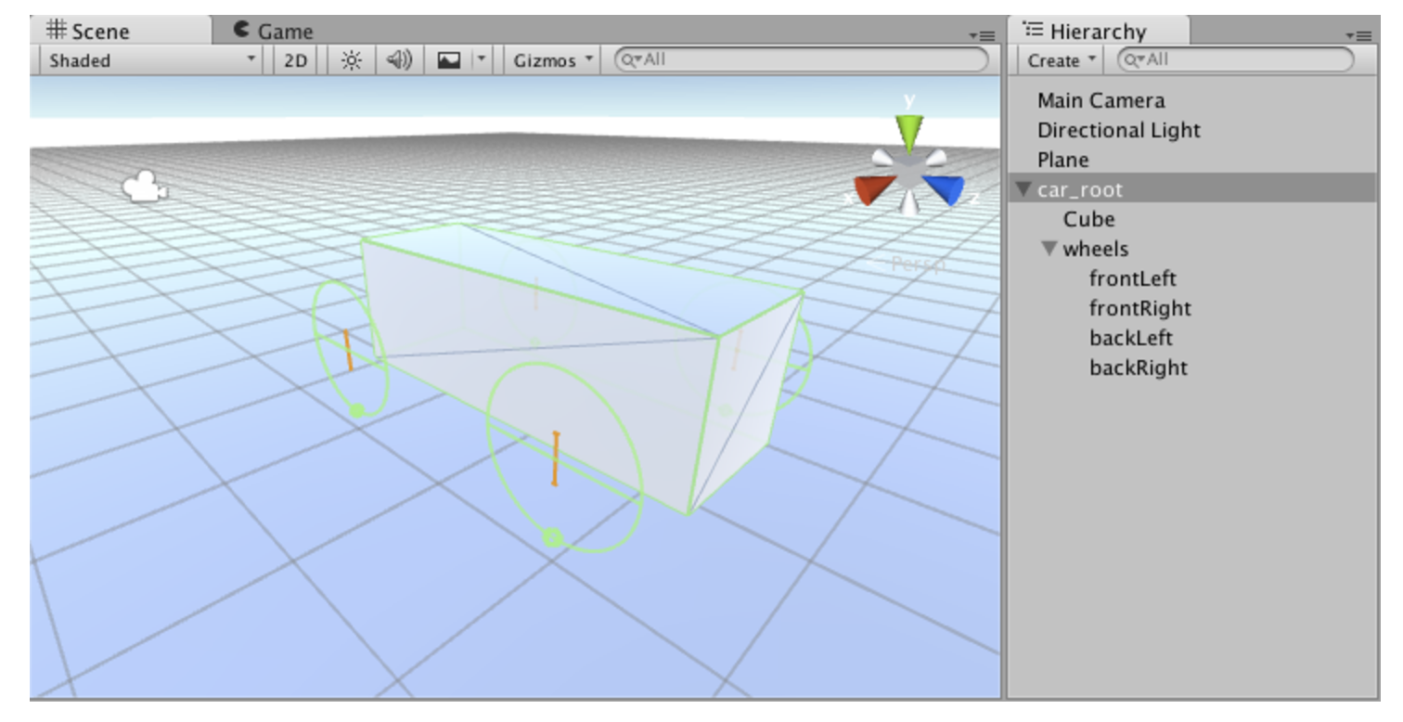
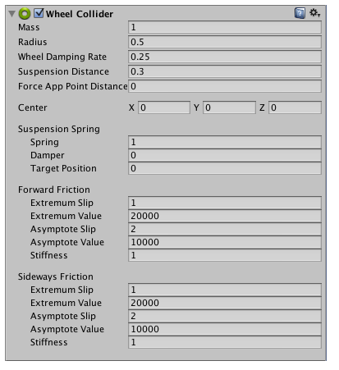
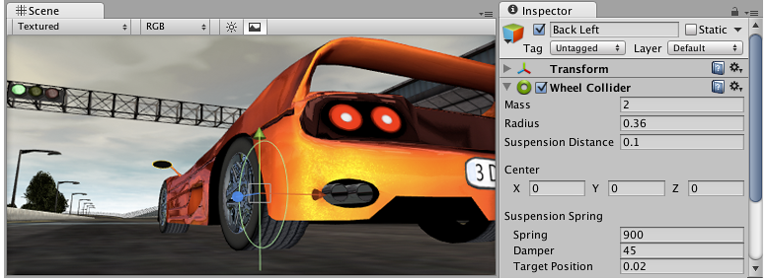
System Realization
Unity3D Simulation
2. UAV and Vehicle control
Wheel collider
The Wheel Collider is a special collider for grounded vehicles. It has built-in collision detection, wheel physics, and a slip-based tire friction model. It can be used for objects other than wheels, but it is specifically designed for vehicles with wheels.

Slide 16
System Realization
Unity3D Simulation
2. UAV and Vehicle control
Input: value of steer, acceleration, footbrake, handbrake Output: movement
Set the steer on the front wheel
Check if the wheel is on the ground
Fix gimbal lock (suddenly shift direction) by changing car body’s moving direction
Apply driving behavior
Add thrust torque to the drive wheel
Speed checking (keep under the Top speed)
Traction control
Check for driving wheels’ tire slip
IF slip > threshold value & torque > 0
Then torque reduce
Else torque increase

Slide 17
System Realization
Unity3D Simulation
3. UAV and Vehicle path planning
Way point tracker – based on path generation
Input: generated path Output: moving tracker
Get controlled object move speed
For every frame set target to new position according to preset-ahead distance and move speed
Update current progress distance and position

Slide 18
System Realization
Unity3D Simulation
3. UAV and Vehicle path planning
Control AI – decide when to slow down
Input: Control movement & target (waypoint tracker) Output: movement control
Get distance and angle between target and current position
Calculate cautiousness parameter according to distance and angle which decide the desire speed
Calculate steering, acceleration, brake parameter based on angle, distance and desire speed
Steering angle aim for the target
Acceleration & brake depend on comparison between desire speed and current speed
Apply movement control

Slide 19
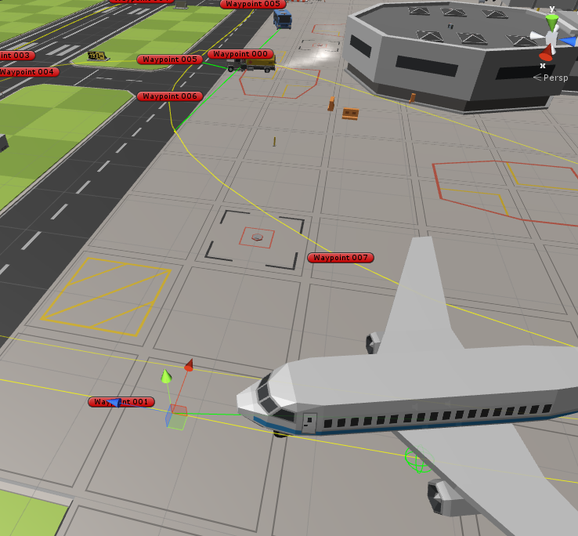
System Realization
Unity3D Simulation
RESULT

Slide 20
System Realization
Named Pipe Transmission
To implement name pipes, use the NamedPipeServerStream and NamedPipeClientStream classes in .NET Framework
Pipe Server
Create pipe server
Create pipe server with name and transmission mode (InOut)
While (pipe is connected)
Get image data
Read every pixels texture data of every camera in RGB format before rendering
Get raw image data
Change data structure, separate R/G/B into three array
transfer data
Transfer the size of picture (NamedPipeServerStream.writeByte())
Transfer the R/ G/ B array (NamedPipeServerStream.write())
Get distance data from client
Read bytes form pipe client (.ReadByte())
End & pipe.close()
Use reference - MATLAB COM(Component Object Model) object
Pipe Client
Create pipe client & connect to pipe server based on pipe name
Create Matlab COM interface load local data (background)
While (pipe is connected)
Receive data from pipe server
Get image size first
Get image R/ G/ B array
Check if the stream is null or correct
Use Matlab function
Invoke matlab function to process image data
Send process result
End & pipe.close()

Slide 21
System Realization
MatLab Image Process
Image data Process
Input: R/G/B array & background image data Output: distance between two object
Reshape R/G/B array into matrix [width, height] based on the picture size
Reverse the R/G/B matrix and combine to full image matrix
Use rgb2gray convert RGB image to gray image
Process, get objects in the image
Background – front
Im2bw change to binary image
Dilate and erode process (fulfill the hole)
Select objects based on area
Draw boundary
Calculate distance based on objects’ boundaries
Return distance

Slide 22
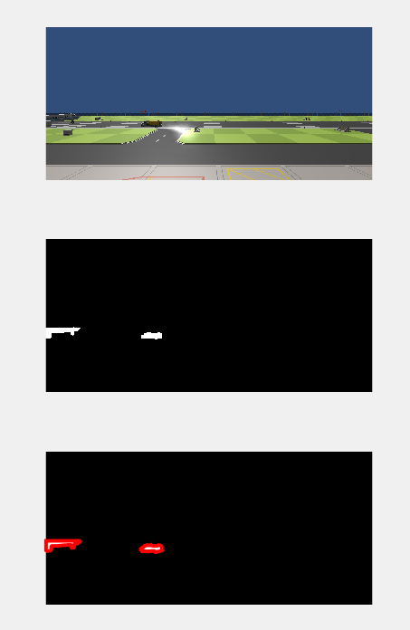
System Realization
MatLab Image Process
Result

Slide 23
Background and Purpose
System Introduction
System Realization
Future Work

Slide 24
Future Work
MatLab
Accuracy
Multiple Objects detection and Object identification
Named Pipe
Time manage based on Multiple threads of multiple pipes
Change to network transmission by using socket

Slide 25
Questions

